Slide 1
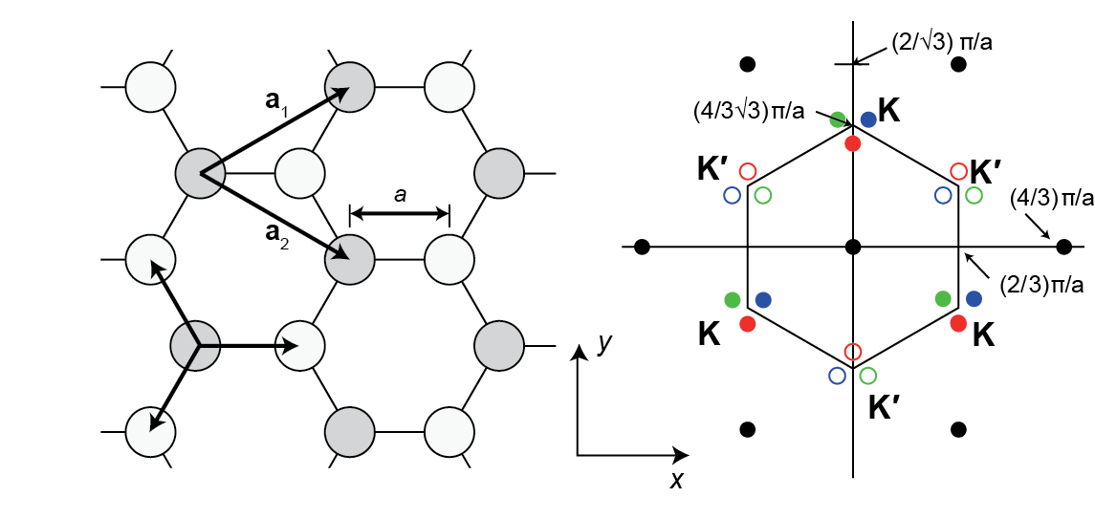
Electronic structure of graphene
References:
Orbital Interactions in Chemistry, Chpt. 13 (in Readings list)
Kuno Chpt. 10
P. R. Wallace, Phys. Rev. 1947, vol. 71, p. 662.
Castro Neto et al., Rev. Mod. Phys. 2009, vol. 81, p. 109.
Nanotubes: T. W. Odom et al., J. Phys. Chem. B 2000, vol. 104, p. 2794.

Slide 2
Electronic structure of graphene and carbon nanotubes
A good description of most real crystals with tight binding requires:
  Extension to 2 or 3 dimensions
  Inclusion of overlap terms (S)
  A multi-orbital basis (multiple atoms and/or multiple atomic orbitals per Bravais lattice site)
The third of these is the most significant: unless basis orbitals are widely separated in energy, the resulting energy bands will include contributions from multiple atomic orbitals.
The “secular determinant”, a result of the variational theorem of quantum mechanics, can be used to find band structures in terms of a small number of parameters, whose values are determined by calculation or experiment.
We’ll look at the band structure of graphene as an example of how this is done.

Slide 3
The secular determinant: Estimating molecular orbital energies in LCAO approach
Express molecular orbitals as sum of atomic orbitals, each with an appropriate coefficient:
From the Schrodinger equation, MO energies e_{i} are given by:
The numerator and denominator are sums of integrals between each of the possible atomic orbital pairs:
(interaction integral)
(overlap integral)

Slide 4
The secular determinant: Estimating molecular orbital energies in LCAO approach
Variational result:
The coefficients that minimize the e_{i}’s are found by solving a system of linear equations:
Because this is a system of homogenous linear equations (RHS = 0), the following determinant must be equal to zero:
This “secular determinant” yields a polynomial for e_{i} whose roots give the MO energies
S_{mm} = 1, H and S terms between distant atoms will be negligible, and H₁₂ = H₂₁* etc.
Coefficients can be worked out once e_{i} are known, but often we’re happy with just e_{i}’s
or
or

Slide 5




Secular determinant: H₂ (or ethylene)
E₂
$$χ_{1}$$
$$χ_{2}$$
E – E₀
Supposing symmetric case (H₁₁=H₂₂=E₀):
E₁
$$E_{1}=\frac{H_{11}+\left|H_{12}\right|}{1+\left|S_{12}\right|}$$
$$E_{2}=\frac{H_{11}−\left|H_{12}\right|}{1−\left|S_{12}\right|}$$
S generally has opposite sign from H
H negative for orbital lobes of same sign

Slide 6
The secular determinant in a periodic lattice:
In a crystal, we take the same variational approach, but starting with a Bloch function for each atomic orbital.
For example:
Our job is then to find energies E_{i} for each value of wavevector k using a secular determinant that accounts for interaction integrals (H’s) and overlap integrals (S’s, if used) between each of the atomic orbital Bloch functions. For example
Bloch function for atomic orbitals ɸ_{A} located at R_{A}
Bloch function for atomic orbitals ɸ_{B} located at R_{B}

Slide 7


Tight-binding model for graphene:
We simplify the secular determinant by neglecting overlap, and noting H_{AA} = H_{BB} for the two equivalent carbon sites in graphene:
B
A
B
A
B
A
B
A
B
$$E=H_{11}±{|H}_{12}|$$
A
B
A
$$\left|H_{12}\right|={√(H}_{21}×H_{12})=√(H_{12}^{∗}×H_{12})$$
Here, the atomic wavefunction is the same for each carbon atom, but R_{A} and R_{B} describe two different Bravais lattices centered on the two different basis sites in the unit cell.
B
A
B

Slide 8
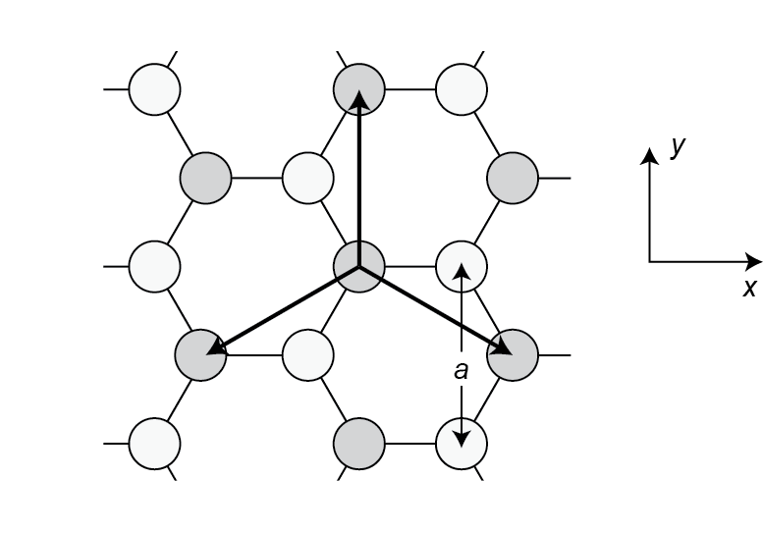
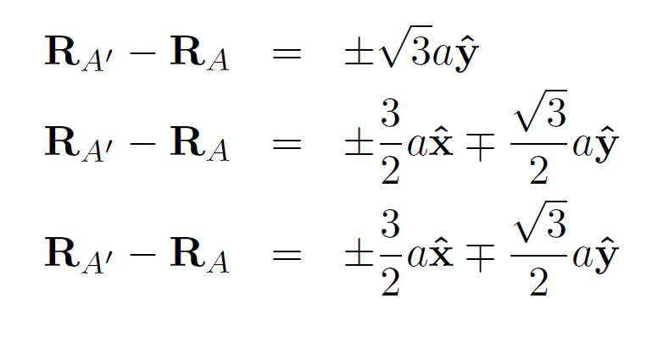
Tight-binding model for graphene:
H₁₁:
Interaction integral for members of the same Bravais lattice (or “sublattice”, i.e. A-A or B-B)
a should be bond length

Slide 9
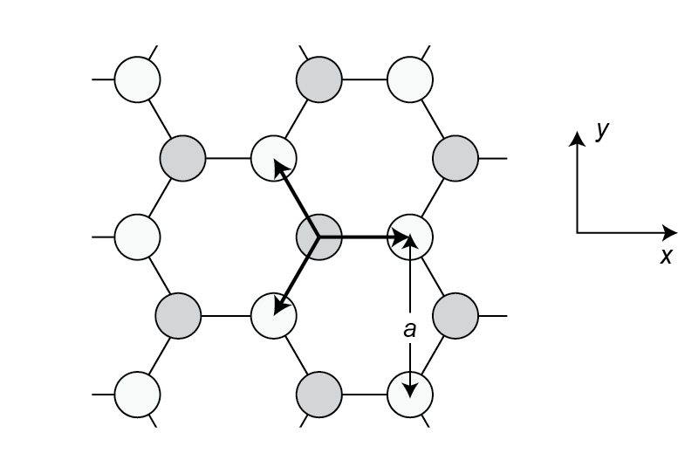
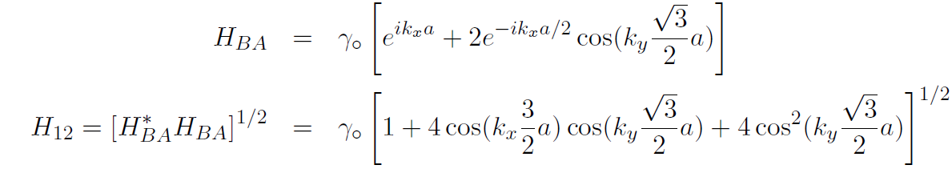
Tight-binding model for graphene:
H₁₂:
Interaction integral for members of the different Bravais lattices (or “sublattice”, i.e. A-B):
a should be bond length

Slide 10
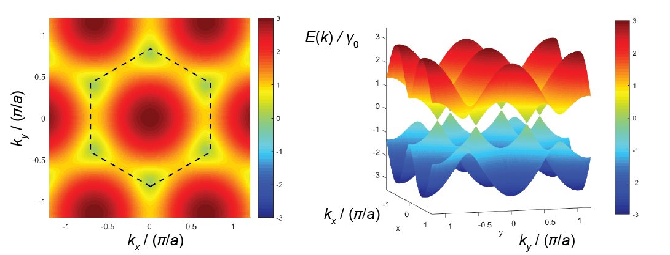

Tight-binding model for graphene:
Putting it together:
$$E=H_{11}±{|H}_{12}|$$
With a the bond length = 1.42Å

Slide 11
Tight-binding model for graphene:
Putting it together:
$$E=H_{11}±{|H}_{12}|$$

Slide 12
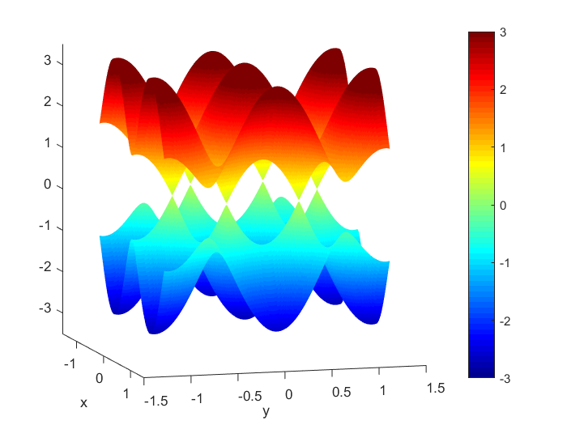
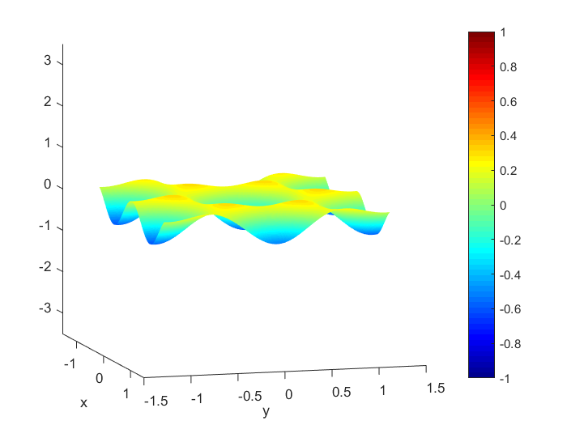
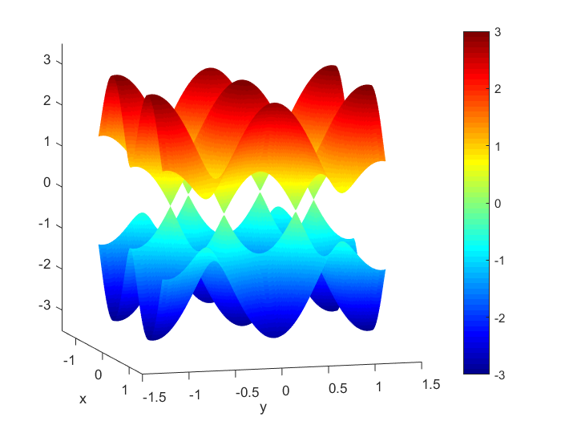
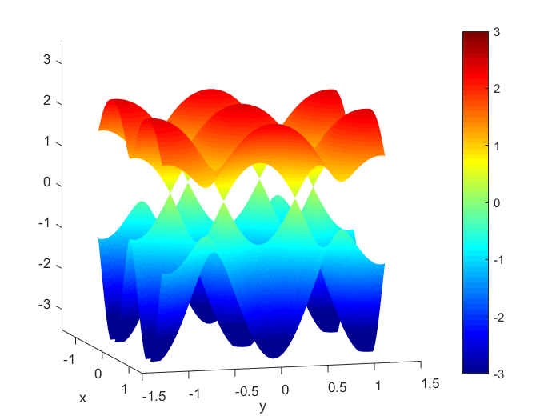


Tight-binding model for graphene:
Putting it together:
$$E=H_{11}±{|H}_{12}|$$
$$γ_{0}^{′}=0.1$$
$$γ_{0}^{}=1.0$$
combined
Add overlap S₁₂= -0.1

Slide 13
ARPES: Angle-resolved photoemission spec.
Cu(111) surface state (hexagonal lattice, 1 electron per site):

Slide 14
ARPES: Angle-resolved photoemission spec.
Tri-layer epitaxial graphene, near K point:

Slide 15
Quantum confinement: Carbon nanotubes

Slide 16
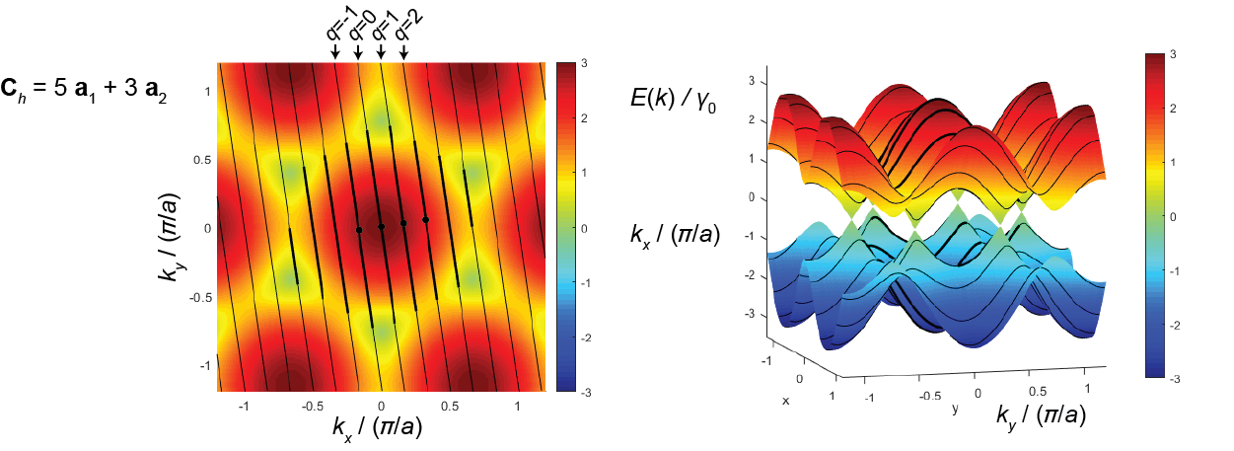
Quantum confinement: Carbon nanotubes: wavefunction must be periodic with roll-up vector

Slide 17
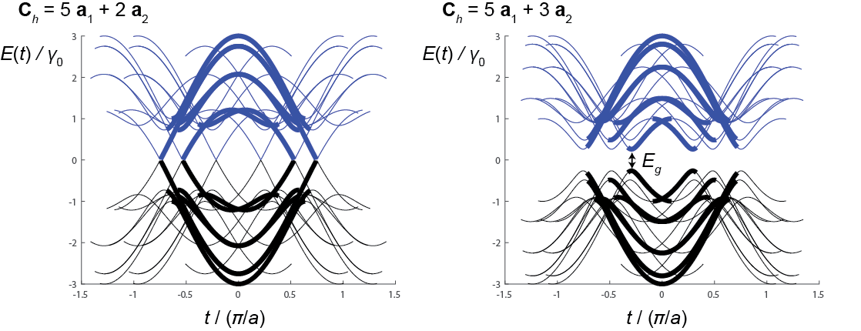
Quantum confinement: Carbon nanotubes
Bands within Brilloiun zone (depicting unique states) highlighted:
… would be better to plot sub-bands within BZ for 1D unit cell defined by translation vector along tube axis.

